Slide 1
Self-Learning and Self-Organizing Log Files by Generating Recursive Associations
K.Indra Gandhi • 04.01.2020

Slide 2
Overview
Introduction
Problem Description
Parsing phase
Initial Categorization
Feature Extraction
Model creation and training
Result and Analysis
Conclusion

Slide 3
INTRODUCTION

Slide 4
Introduction
The increase in the effective usage of computer systems have paved way for the generation of enormous logs.
Some of the existing classification set which may vary on different logs.
Accomplishment 2
The classification of the logs may provide a greater insight on the data that is collected continuously.
Our approach is a novel approach where we try to cluster the group automatically by learning the pattern and their association with the other information available.

Slide 5
Introduction(Cont..)
System logs generate voluminous data which can be effectively handled by continuously learning the pattern in which the logs are repeated.
This technique actually minimizes the record size without deviating from actual information to be observed.
Accomplishment 2
To assign category to those reduced record set, frequency of each token is found and its probabilities are compared to get frequently recurring tokens.
The occurrence of these categories across timestamps are examined so as to observe the change in the group of categories determined.

Slide 6
PROBLEM DESCRIPTION

Slide 7
Problem Description
Features are extracted from log and classified based on Multinomial Bayes model.
The lifetime of these clusters is observed so as to understand the pattern in which the log information is generated.
Apart from finding root cause, Our work examines these categories as cluster of information.
Automatic classification of the categories and their corresponding sub-categories help in associating the links that has to be tracked.

Slide 8
It is meant to find the underlying structure of data we are given.
It is meant to reduce the number of resources needed
Initial Categorization
Parsing
Feature Extraction
Model Creation and training
Involves finding initial set of classes available in data we are given
Creates model and provides training data to learn from

Slide 9
Parsing phase
The system logs are parsed with reference to the common tag .
The log files are pre-processed and duplicates are removed so as to precise the categorization.
Tokenizing the log data into different fields :
Timestamp
Event
Process
Category
Category ID.

Slide 10
Initial Categorization phase
The parsed raw log items are normalized,
Stop words removal
Non-alphanumeric data removal.
This vocabulary helps in filtering out records that are prone to anomalies.
For this sole purpose, we create a vocabulary out of all commonly occurring anomalies.
Recursively obtaining another level of categorization in order to understand the cause of these related logs.

Slide 11
Feature Extraction phase
The features are extracted based on the term frequency (tf) and inverse document frequency(idf).
The log files are pre-processed and duplicates are removed so as to precise the categorization.
The product of tf and idf is used to emphasize the importance of a keyword or phrase within dataset.
Here, multiple attributes plays feature role and generate feature matrix out of it.

Slide 12
Model Creation and Training phase
Train/Test split of dataset is done before Countvectorizer.
Steps in vectorization :
Instantiate Countvectorizer
Fit to learn feature
Transform.
We use Countvectorizer to convert text into token counts as the algorithm expects numerical feature vector.
Now as result we got the document - term matrix.
We instantiate Multinomial Naïve Bayes model and training it by fitting the vector.

Slide 13
RESULT AND ANALYSIS

Slide 14
Perception
No of events classified into that category
P(category) =
Total number of events
By computing the categories and subcategories, an n-ary tree is generated.
The Category with high dominance over a period of time is taken for higher insights.
The conditional probability for calculating the subcategory is the probability of the events that occur in a particular category.

Slide 15
Association Generation
DEVICE STATE CHANGE
HOSTNAME CONFLICT
WARNING
1
3
5
2
4
ERROR
SERVER MISBEHAVING

Slide 16
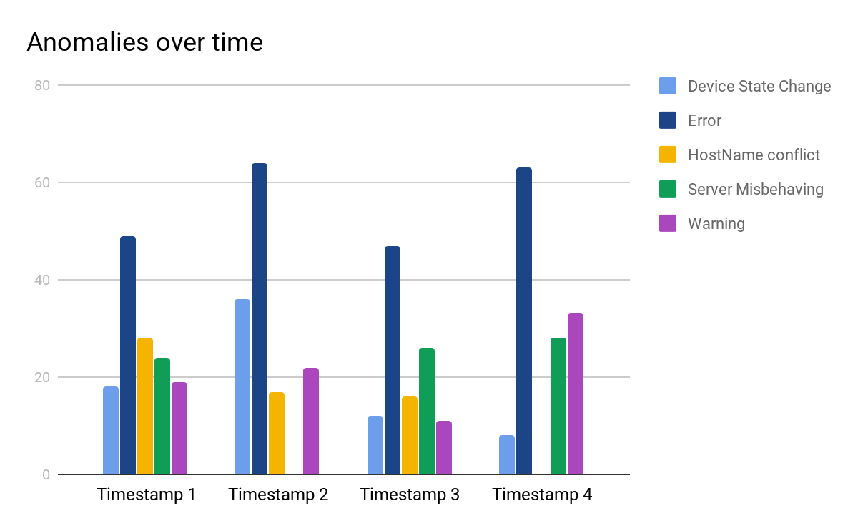
Stats

Slide 17
CONCLUSION

Slide 18
Conclusion
Thus Self-learning techniques on voluminous logs creates the categorization of logs such that the root cause of a particular log can be identified precisely.
The occurrence of any event on the network has to be recorded so as to ensure transparency and security in the network.
The model is trained and tested which shows an accuracy of 96% , the accuracy improves as the subclasses grow over time.

Slide 19
Queries?.

